Slide 1
INTRO to natural language processing
10/2019
Analytics Consulting Group

Slide 2
All workshop materials can be found here:
bit.ly/2ICgMT4

Slide 3

Who am I?
Dev Sharma
Applied Analytics Student (Fall 2018 Batch)
Undergrad: University of Memphis B.B.A.
Worked in Boutique Tech. Consulting for four years
Interned with Infosys this past summer
Focus heavily on NLP with Python

Slide 4
Contents
What is NLP?
Examples of NLP applications
Regular Expressions
Types of NLP Tasks
Tokenization
Count vs. TFIDF Vectorization
Topic Modelling with SVD and PCA
Naïve Bayes Classifier
Embeddings / Word2Vec Models
Recurrent Neural Networks
Transformers / Transfer Learning
Ethical Implications

Slide 5
What is Natural Language Processing?
Helps machines understand human languages, bridging the “language barrier” between machines and humans so to speak
This is how we understand the world around us:

Slide 6
What is NLP (continued)?
This is how machines are taught to perceive the data we feed them:

Slide 7
Examples of NLP Demo Applications
Named Entity Recognition
https://demo.allennlp.org/named-entity-recognition
Part of Speech Tagging
http://www.infogistics.com/posdemo.htm
Text Generation
https://talktotransformer.com/
QA
https://www.pragnakalp.com/demos/BERT-NLP-QnA-Demo

Slide 8
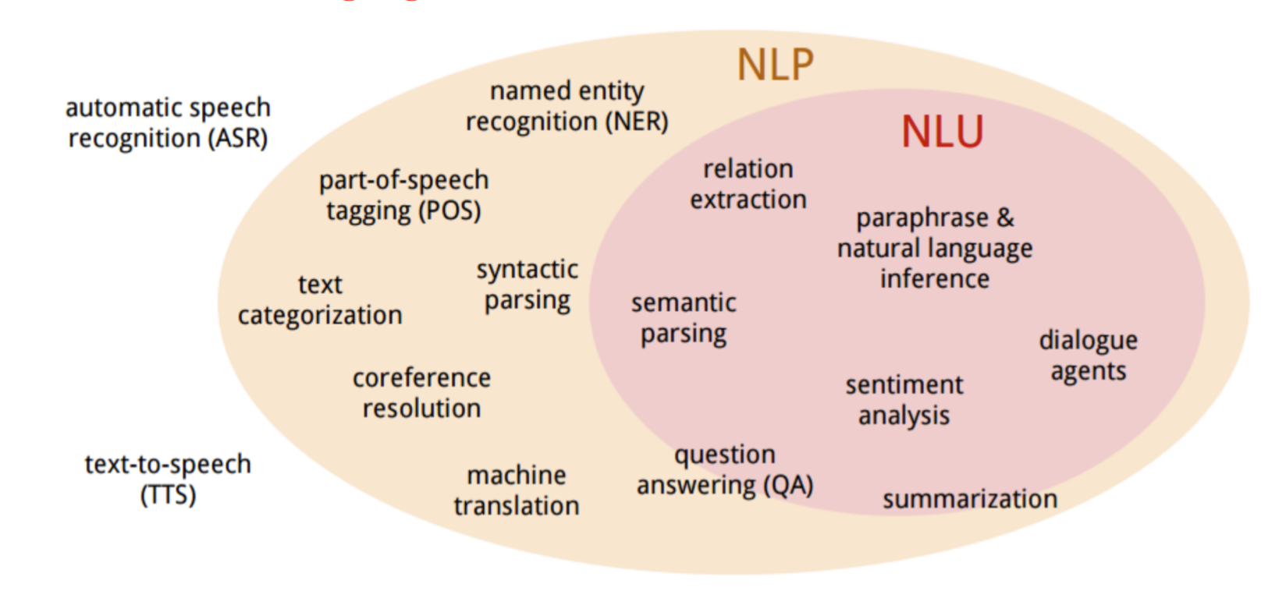
Types of NLP Tasks
- NLP and NLU (U = Understanding) are often used interchangeably

Slide 9
Other
Rest of the material will be covered along with the workshop Jupyter notebook at bit.ly/2ICgMT4

Slide 10
Resources
Courses
Fast.ai - Code-First Introduction to NLP
https://www.fast.ai/2019/07/08/fastai-nlp/
Articles
NLP vs. NLU
https://www.bmc.com/blogs/nlu-vs-nlp-natural-language-understanding-processing/

Slide 11
Q & A
Connect with me on LinkedIn with any follow-up Questions:
https://www.linkedin.com/in/dev-sharma1/

